Slide 1
Controlling Traveling-Wave Phonons at Room Temperature
Joel N. Johnson
April 25th, 2025
Northern Arizona University

Slide 2
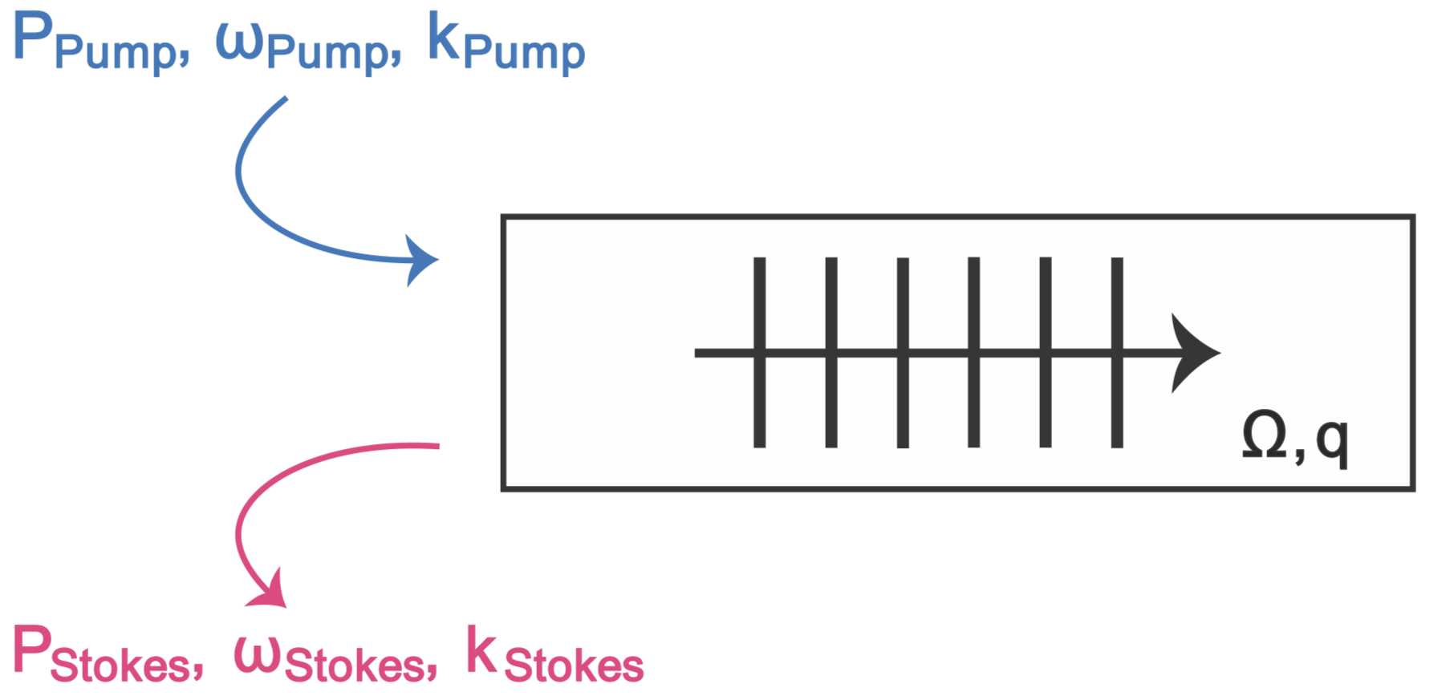
Brillouin Scattering: Optomechanical Coupling

Slide 3
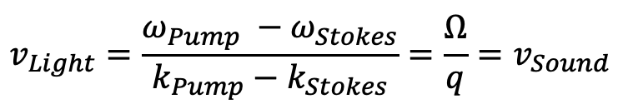
Brillouin Scattering: Optomechanical Coupling
Phase (velocity) matching:
$$v_{Light}=\frac{ω_{Pump} −ω_{Stokes}}{k_{Pump}−k_{Stokes}}=\frac{Ω}{q}=v_{Sound}$$

Slide 4
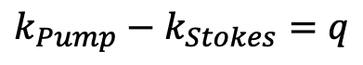
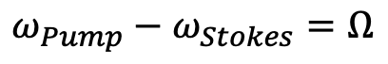
Brillouin Scattering: Optomechanical Coupling
Phase (velocity) matching:
$$v_{Light}=\frac{ω_{Pump} −ω_{Stokes}}{k_{Pump}−k_{Stokes}}=\frac{Ω}{q}=v_{Sound}$$
✓
Energy Conservation:
$$ω_{Pump}−ω_{Stokes}=Ω$$
✓
Momentum Conservation:
$$k_{Pump}−k_{Stokes}=q$$

Slide 5
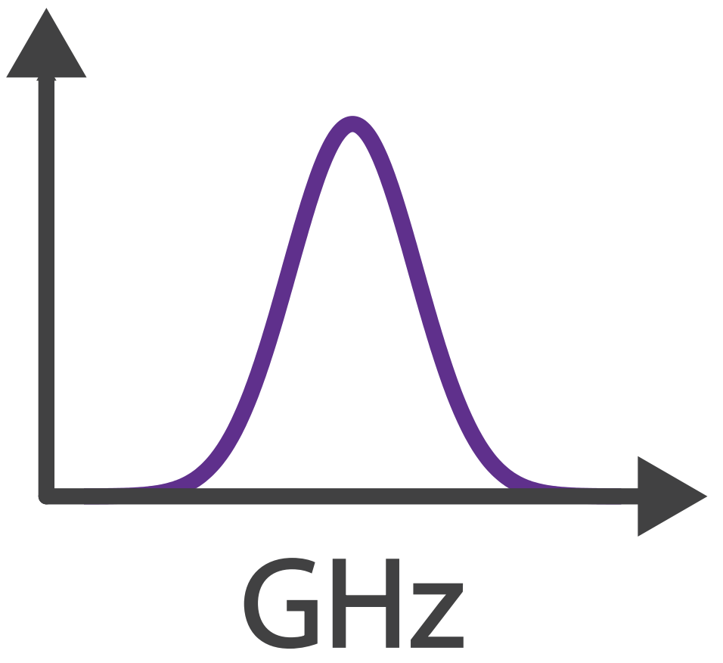

Brillouin Scattering: Optomechanical Coupling
Phase (velocity) matching:
$$v_{Light}=\frac{ω_{Pump} −ω_{Stokes}}{k_{Pump}−k_{Stokes}}=\frac{Ω}{q}=v_{Sound}$$
✓
Energy Conservation:
$$ω_{Pump}−ω_{Stokes}=Ω$$
✓
Momentum Conservation:
$$k_{Pump}−k_{Stokes}=q$$
$$Ω$$

Slide 6
Controlling Sound with Light
Laser Cooling of Traveling-Wave Phonons in an Optical Fiber
Quieting sound with light

Slide 7
Controlling Sound with Light
Laser Cooling of Traveling-Wave Phonons in an Optical Fiber
Quieting sound with light
Coherently stimulated Brillouin Scattering (CoBS)
Amplifying sound to measure subtle signals

Slide 8
Controlling Sound with Light
Laser Cooling of Traveling-Wave Phonons in an Optical Fiber
Quieting sound with light
Coherently stimulated Brillouin Scattering (CoBS)
Amplifying sound to measure subtle signals
Brillouin-Induced Raman Modes
Harnessing sound for engineered behaviors

Slide 9
Laser Cooling
Why do we care about laser cooling?
Reduce thermal noise
Access quantum regimes

Slide 10
Laser Cooling
Why do we care about laser cooling?
Reduce thermal noise
Access quantum regimes
Demonstrated for discrete cavity systems
Resonant cavities permit discrete modes
Tune laser just red of cavity resonance → discrete mode cooling

Slide 11
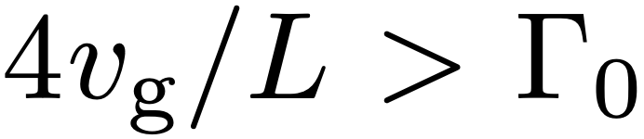
Laser Cooling of a Continuum of Modes
Fast escape condition
Remove phonons faster than they are replenished:

Slide 12
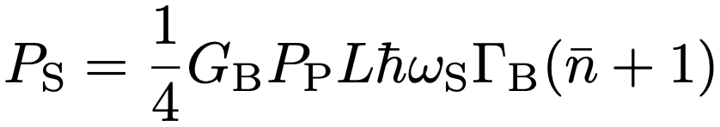
Laser Cooling of a Continuum of Modes
Fast escape condition
Remove phonons faster than they are replenished:
Challenging because scattered power scales with length:

Slide 13
Laser Cooling of a Continuum of Modes
Fast escape condition
Remove phonons faster than they are replenished:
Challenging because scattered power scales with length:
Gain
Power
Thermal

Slide 14
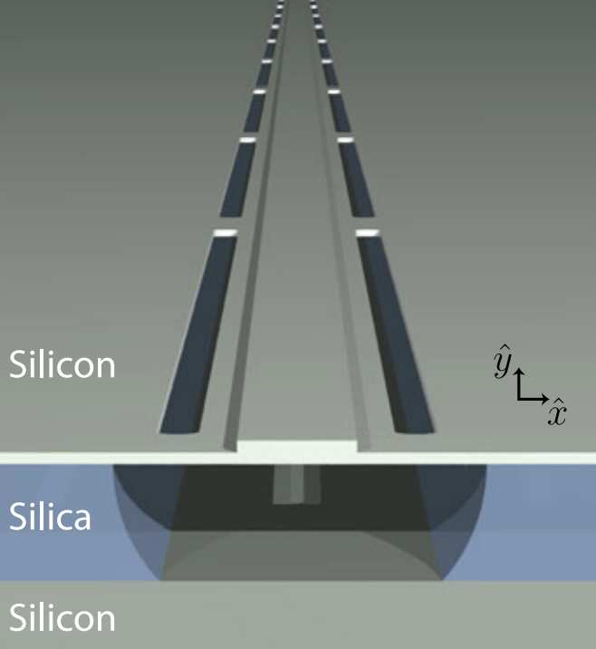
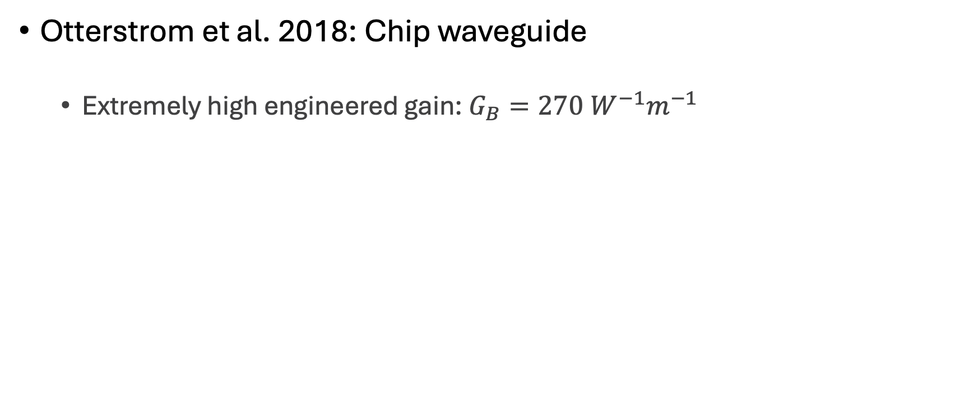
Laser Cooling of a Continuum of Modes
Otterstrom et al. 2018: Chip waveguide
Extremely high engineered gain: $G_{B}=270 W^{−1}m^{−1}$

Slide 15
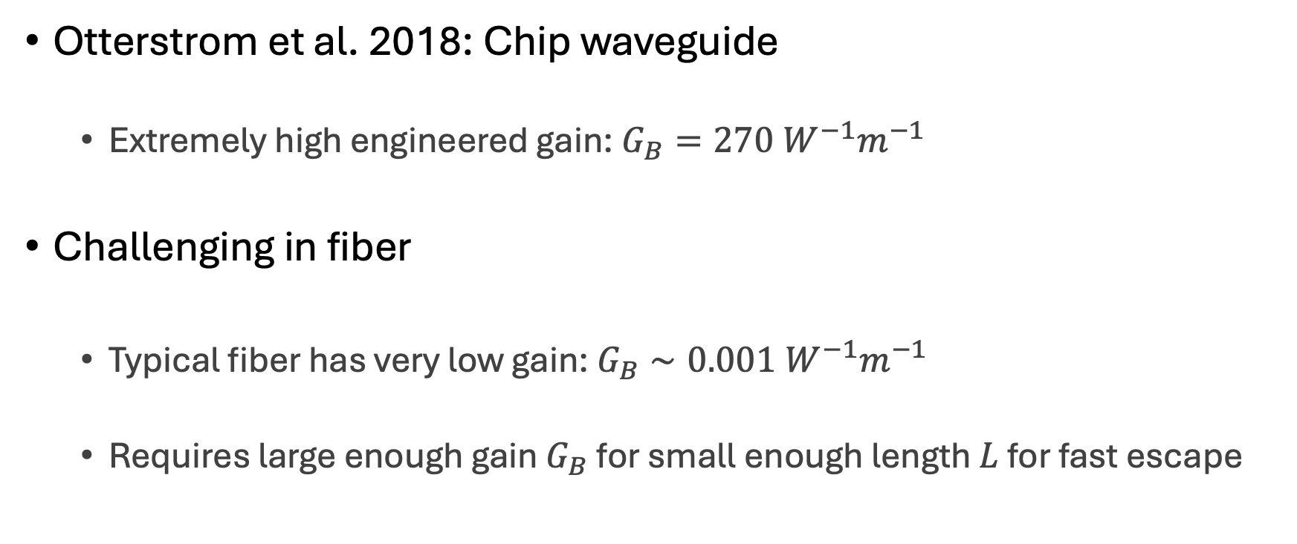
Laser Cooling of a Continuum of Modes
Otterstrom et al. 2018: Chip waveguide
Extremely high engineered gain: $G_{B}=270 W^{−1}m^{−1}$
Challenging in fiber
Typical fiber has very low gain: $G_{B}∼0.001 W^{−1}m^{−1}$
Requires large enough gain $G_{B}$ for small enough length $L$ for fast escape

Slide 16
Solution: CS₂
Carbon disulfide (CS₂) is a very high gain liquid

Slide 17
Solution: CS₂-Filled Liquid-Core Optical Fiber
Carbon disulfide (CS₂) is a very high gain liquid
Fill hollow-core optical fiber with CS₂:
1 meter
SMF-28
UHNA7
hollow-core
UHNA7
SMF-28
~1.68 µm

Slide 18
Solution: CS₂-Filled Liquid-Core Optical Fiber
Carbon disulfide (CS₂) is a very high gain liquid
Fill hollow-core optical fiber with CS₂:
1 meter
SMF-28
UHNA7
hollow-core
UHNA7
SMF-28
~1.68 µm

Slide 19
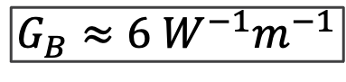
Solution: CS₂-Filled Liquid-Core Optical Fiber
Carbon disulfide (CS₂) is a very high gain liquid
Fill hollow-core optical fiber with CS₂:
1 meter
SMF-28
UHNA7
hollow-core
UHNA7
SMF-28
~1.68 µm
$$G_{B}≈6 W^{−1}m^{−1}$$

Slide 20
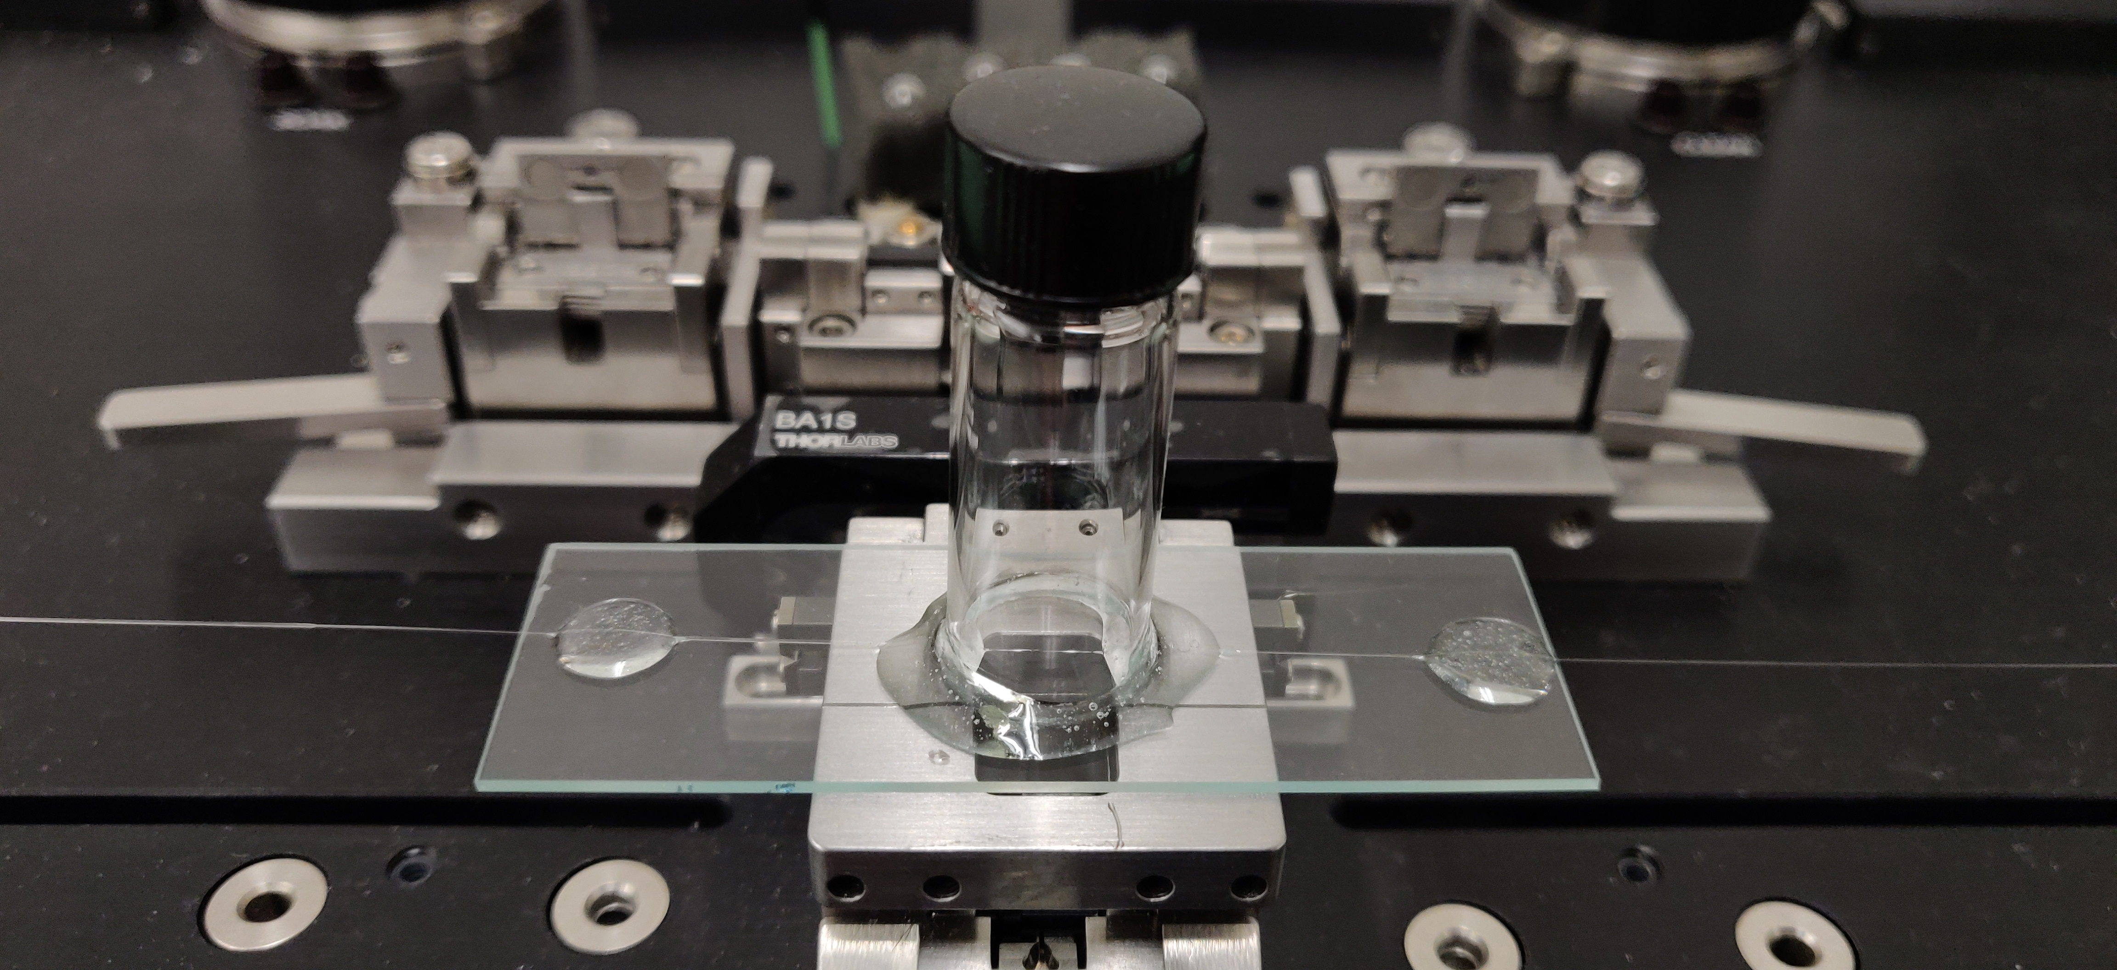
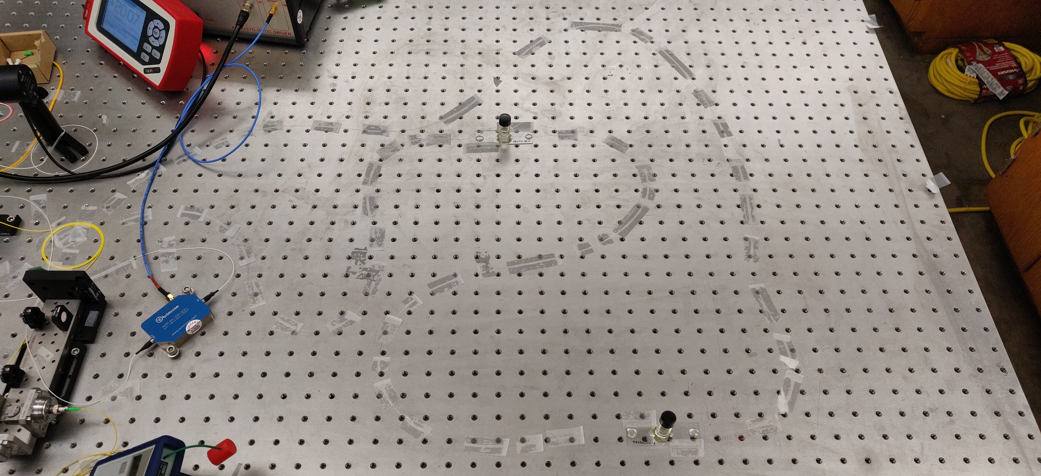
Liquid-core Optical Fiber Sample

Slide 21
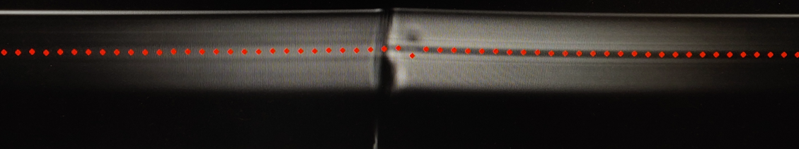
Liquid-core Optical Fiber Sample

Slide 22
Liquid-core Optical Fiber Sample
CS₂ enters here

Slide 23

Liquid-core Optical Fiber Sample
CS₂ enters here

Slide 24
Cooling Figure of Merit
All materials have a natural rate of mechanical dissipation (Γ₀)

Slide 25
Cooling Figure of Merit
All materials have a natural rate of mechanical dissipation (Γ₀)
To cool is to increase dissipation rate (Γ₊)

Slide 26
Cooling Figure of Merit
All materials have a natural rate of mechanical dissipation (Γ₀)
To cool is to increase dissipation rate (Γ₊)
Spectral linewidth gives dissipation rate
Γ

Slide 27
Cooling Figure of Merit
All materials have a natural rate of mechanical dissipation (Γ₀)
To cool is to increase dissipation rate (Γ₊)
Spectral linewidth gives dissipation rate
Broadened linewidth gives measure of cooling
Γ

Slide 28
Cooling Figure of Merit
Broadened linewidth gives measure of cooling

Slide 29
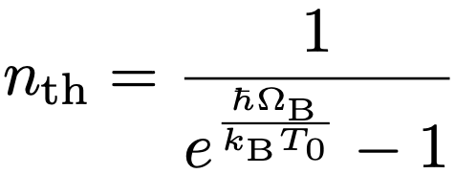
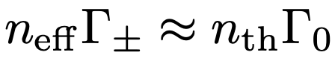
Cooling Figure of Merit
Broadened linewidth gives measure of cooling:

Slide 30
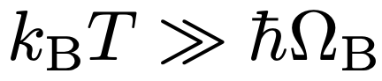
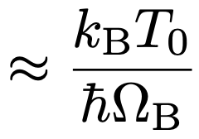
Cooling Figure of Merit
Broadened linewidth gives measure of cooling:

Slide 31
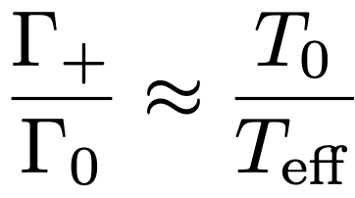
Cooling Figure of Merit
Broadened linewidth gives measure of cooling:

Slide 32
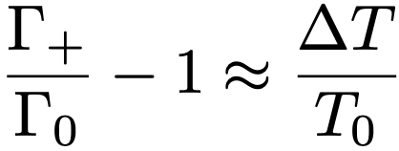
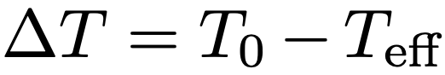
Cooling Figure of Merit
Broadened linewidth gives measure of cooling:

Slide 33
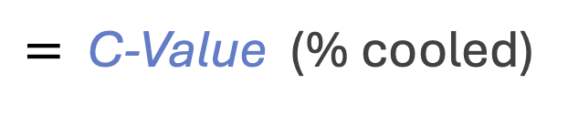
Cooling Figure of Merit
Broadened linewidth gives measure of cooling:
$=$ C-Value (% cooled)

Slide 34
Experimental Setup

Slide 35
Results
Γ

Slide 36
Results
Γ

Slide 37
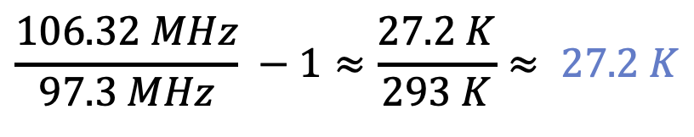
Results
Γ
$$\frac{106.32 MHz}{97.3 MHz} −1≈\frac{27.2 K}{293 K}≈ 27.2 K$$
cooling from room temperature

Slide 38
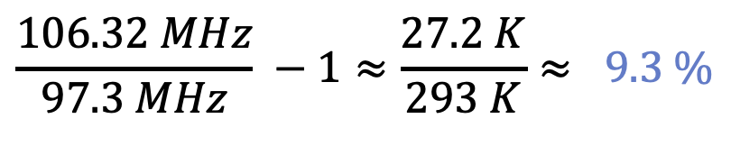
Results
Γ
$$\frac{106.32 MHz}{97.3 MHz} −1≈\frac{27.2 K}{293 K}≈ 9.3 \%$$
C-Value

Slide 39
Controlling Sound with Light
Laser Cooling of Traveling-Wave Phonons in an Optical Fiber
Quieting sound with light
Coherently stimulated Brillouin Scattering (CoBS)
Amplifying sound to measure subtle signals

Slide 40
Controlling Sound with Light
Laser Cooling of Traveling-Wave Phonons in an Optical Fiber
Quieting sound with light
Coherently stimulated Brillouin Scattering (CoBS)
Amplifying sound to measure subtle signals

Slide 41
Brillouin Spectroscopy
What is Brillouin spectroscopy?
Measurement of mechanical properties of materials
Obtain mechanical resonances, elastic moduli

Slide 42
Brillouin Spectroscopy
What is Brillouin spectroscopy?
Measurement of mechanical properties of materials
Obtain mechanical resonances, elastic moduli
Where is it used?
Biomechanics and medical diagnostics
Distributed fiber-optic strain and temperature monitoring along structures

Slide 43
Traditional Brillouin Scattering
Spontaneous Brillouin scattering
Thermal phonons

Slide 44
Traditional Brillouin Scattering
Spontaneous Brillouin scattering
Thermal phonons
Stimulated Brillouin scattering
Inject Stokes seed
Self-reinforcing process

Slide 45
Traditional Brillouin Scattering
Would be nice to drive with Stokes
Problem: drowns the signal

Slide 46
Coherently Stimulated Brillouin Scattering?
Would be nice to drive with Stokes
Problem: drowns the signal
Separate, shifted probe laser?
Incoherent with driven phonon mode
Would not “talk” to the driven phonons (unphase-matched)

Slide 47
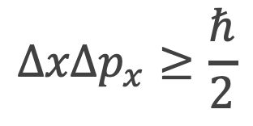
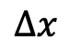
Phase Matching Relaxation
At small scales, position certainty means momentum uncertainty
$$ΔxΔp_{x}≥\frac{ℏ}{2}$$
Heisenberg uncertainty principle
$$Δx$$

Slide 48
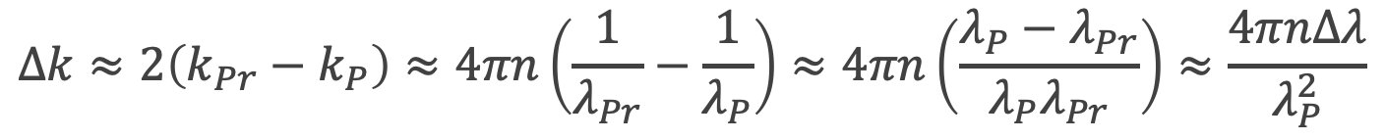
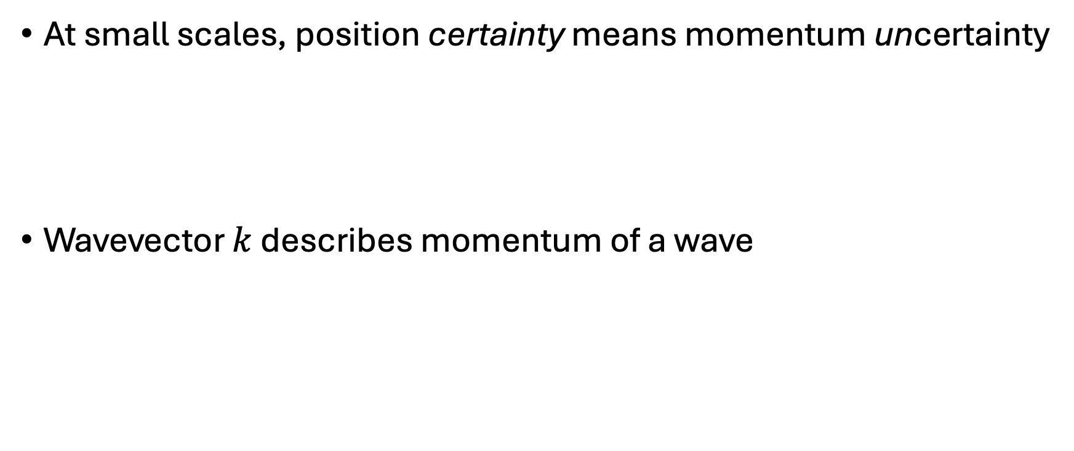
Phase Matching Relaxation
At small scales, position certainty means momentum uncertainty
Wavevector $k$ describes momentum of a wave
$$ΔxΔp_{x}≥\frac{ℏ}{2}$$
$$Δk≈2\left(k_{Pr}−k_{P}\right)≈4πn\left(\frac{1}{λ_{Pr}}−\frac{1}{λ_{P}}\right)≈4πn\left(\frac{λ_{P}−λ_{Pr}}{λ_{P}λ_{Pr}}\right)≈\frac{4πnΔλ}{λ_{P}^{2}}$$

Slide 49
Phase Matching Relaxation
At small scales, position certainty means momentum uncertainty
Wavevector $k$ describes momentum of a wave
$$ΔxΔp_{x}≥\frac{ℏ}{2}$$
Pump-probe detuning
$$Δk≈2\left(k_{Pr}−k_{P}\right)≈4πn\left(\frac{1}{λ_{Pr}}−\frac{1}{λ_{P}}\right)≈4πn\left(\frac{λ_{P}−λ_{Pr}}{λ_{P}λ_{Pr}}\right)≈\frac{4πnΔλ}{λ_{P}^{2}}$$

Slide 50
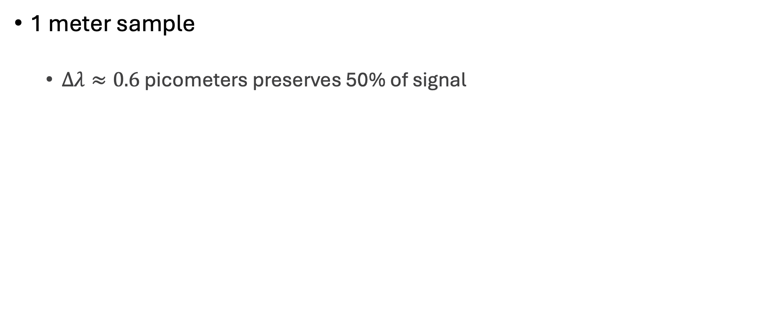
Cheating Phase Matching
1 meter sample
$Δλ≈0.6$ picometers preserves 50% of signal

Slide 51
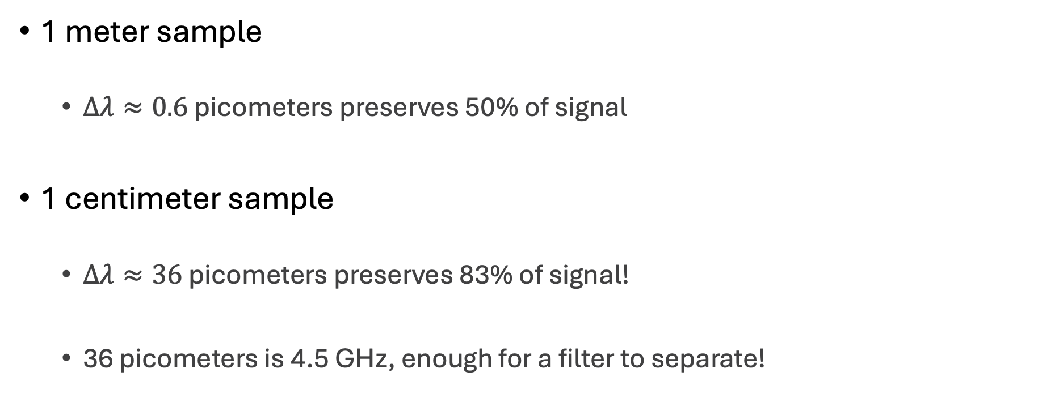
Cheating Phase Matching
1 meter sample
$Δλ≈0.6$ picometers preserves 50% of signal
1 centimeter sample
$Δλ≈36$ picometers preserves 83% of signal!
36 picometers is 4.5 GHz, enough for a filter to separate!

Slide 52
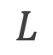
Coherently Stimulated Brillouin Spectroscopy
Allows Stokes driving while preserving coherence with a shifted probe
$$L$$

Slide 53
Coherently Stimulated Brillouin Spectroscopy
Allows Stokes driving while preserving coherence with a shifted probe
~1 million times more powerful than traditional SBS!
$$L$$

Slide 54
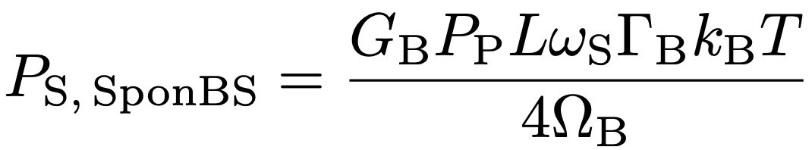
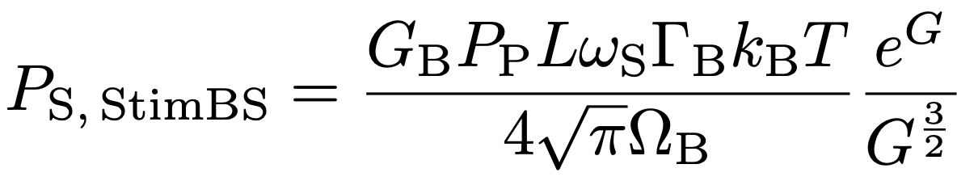
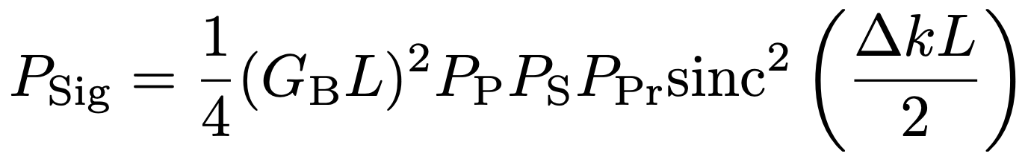
CoBS vs StimBS vs SponBS
Spontaneous BS
Stimulated BS
CoBS

Slide 55
CoBS vs StimBS vs SponBS

Slide 56
CoBS:

Slide 57
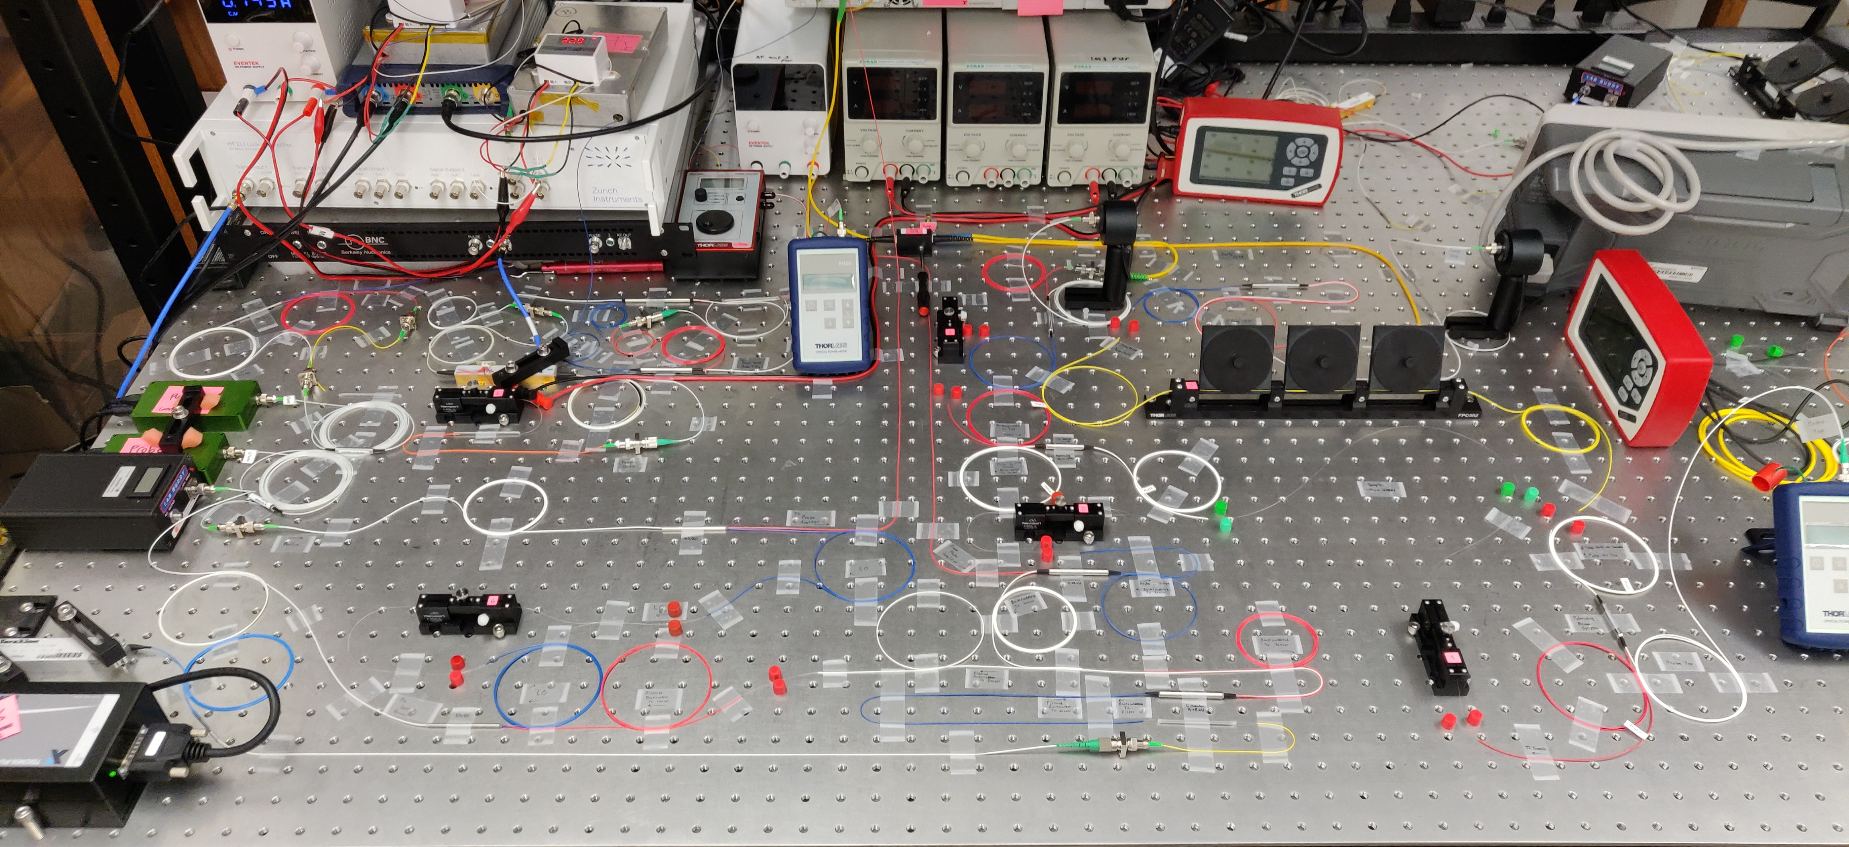
CoBS:

Slide 58
Controlling Sound with Light
Laser Cooling of Traveling-Wave Phonons in an Optical Fiber
Quieting sound with light
Coherently stimulated Brillouin Scattering (CoBS)
Amplifying sound to measure subtle signals
Brillouin-Induced Raman Modes
Harnessing sound for engineered behaviors

Slide 59
Controlling Sound with Light
Laser Cooling of Traveling-Wave Phonons in an Optical Fiber
Quieting sound with light
Coherently stimulated Brillouin Scattering (CoBS)
Amplifying sound to measure subtle signals
Brillouin-Induced Raman Modes
Harnessing sound for engineered behaviors

Slide 60
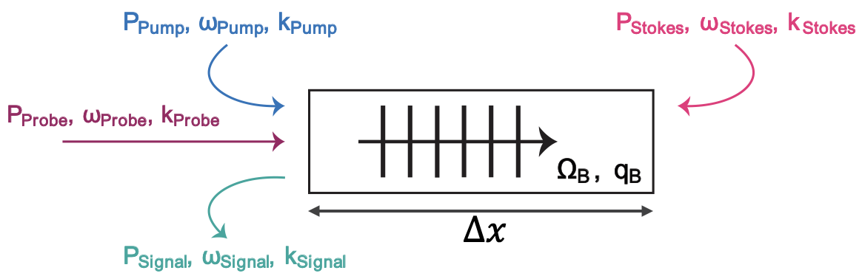
Explore Brillouin/Raman Transition
Brillouin
Travelling-wave phonons in bulk material
CoBS
Travelling Wave Phonons

Slide 61
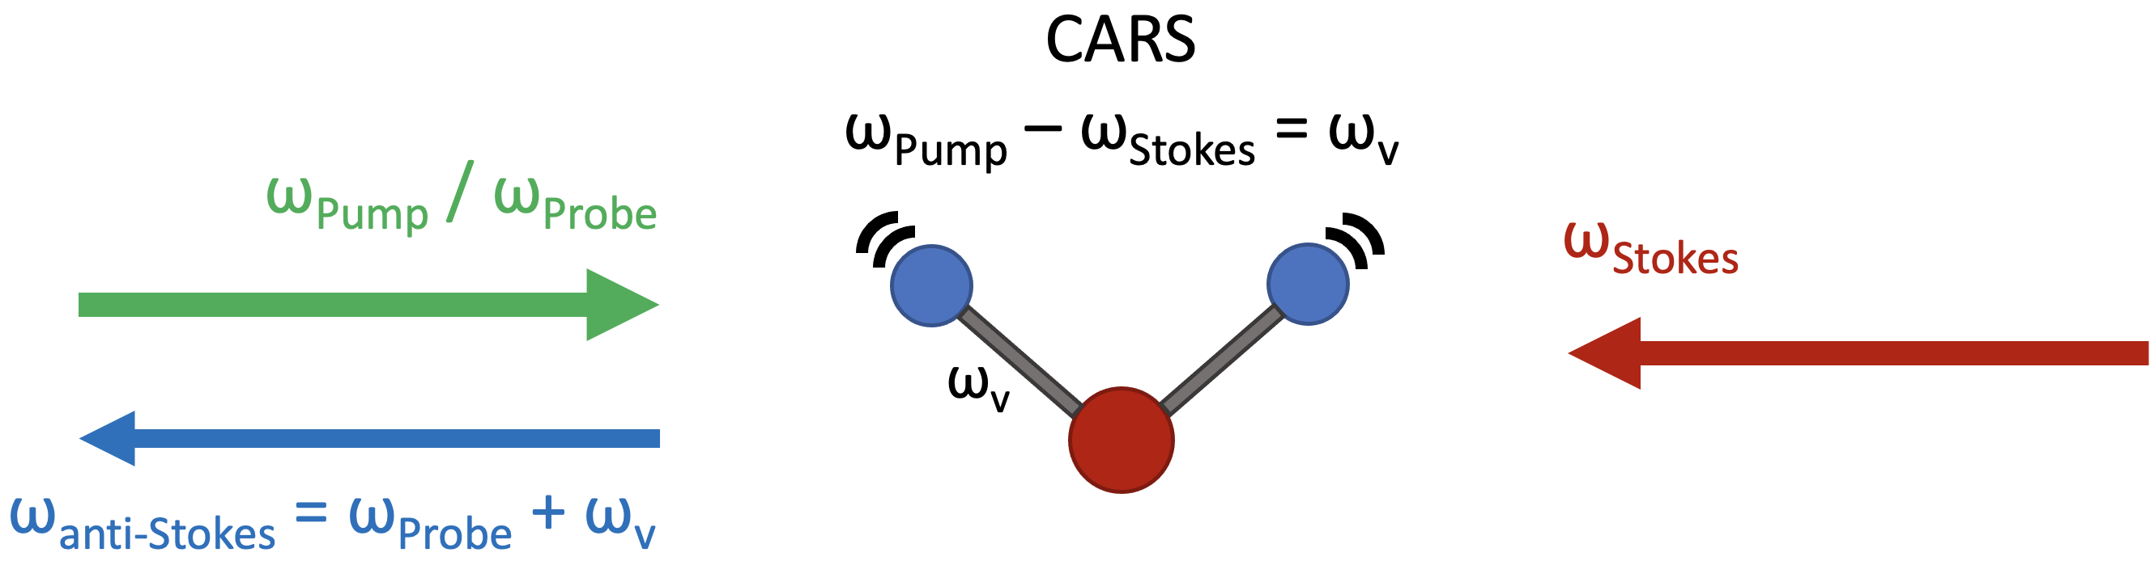
Explore Brillouin/Raman Transition
Brillouin
Travelling-wave phonons in bulk material
Raman
Standing wave phonons in molecular vibrations
CoBS
Travelling Wave Phonons
Standing Wave Phonons

Slide 62
Explore Brillouin/Raman Transition
Brillouin
Travelling-wave phonons in bulk material
Raman
Standing wave phonons in molecular vibrations
Start in Brillouin domain and approach Raman-like modes
CoBS
Travelling Wave Phonons
Standing Wave Phonons

Slide 63
Reflected Phonons Create Standing Waves
Ω
Ω

Slide 64
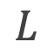
In-Phase Phonons Constructively Interfere
$$L$$
Ω
Ω

Slide 65
In-Phase Phonons Constructively Interfere
$$L$$
Ω
Ω

Slide 66
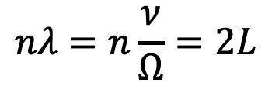
In-Phase Phonons Constructively Interfere
$$nλ=n\frac{ν}{Ω}=2L$$
$$L$$
Ω
Ω

Slide 67
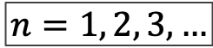
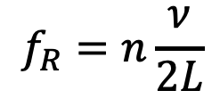
In-Phase Phonons Constructively Interfere
$$nλ=n\frac{ν}{Ω}=2L$$
$$L$$
$$f_{R}=n\frac{ν}{2L}$$
$$n=1, 2, 3, …$$
Ω
Ω

Slide 68
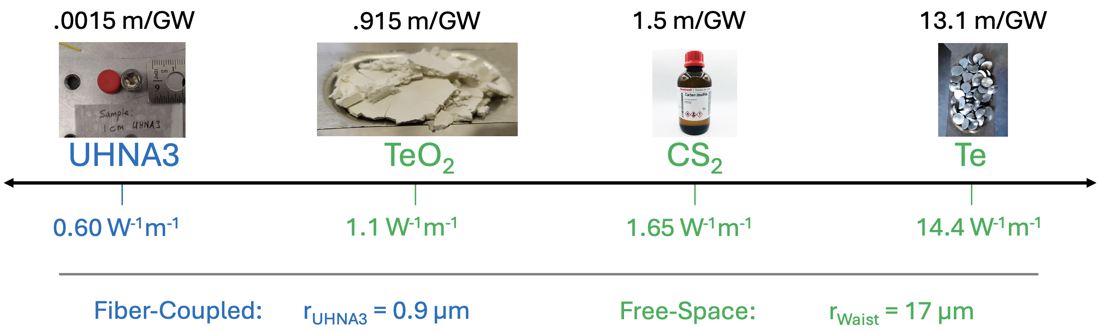
Gain of Relevant Materials

Slide 69
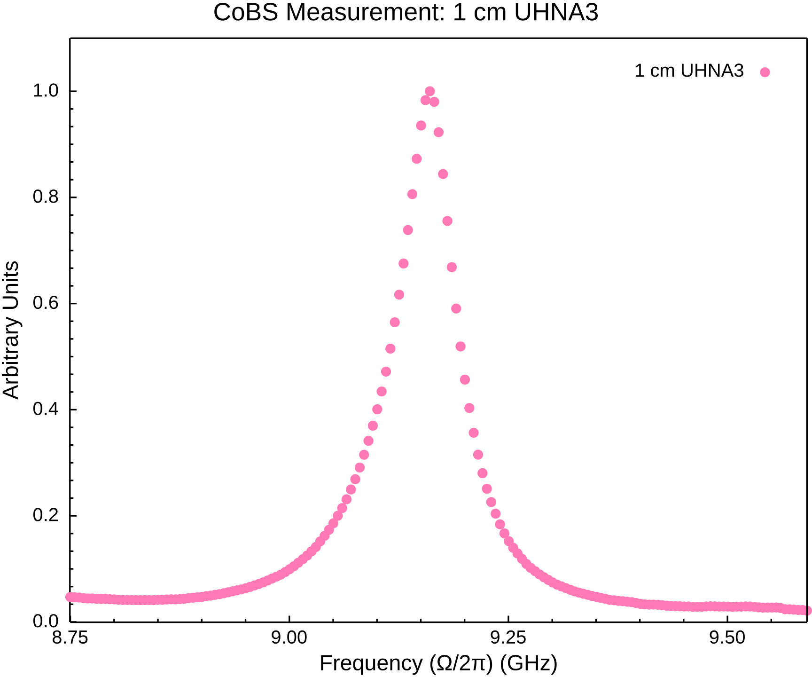
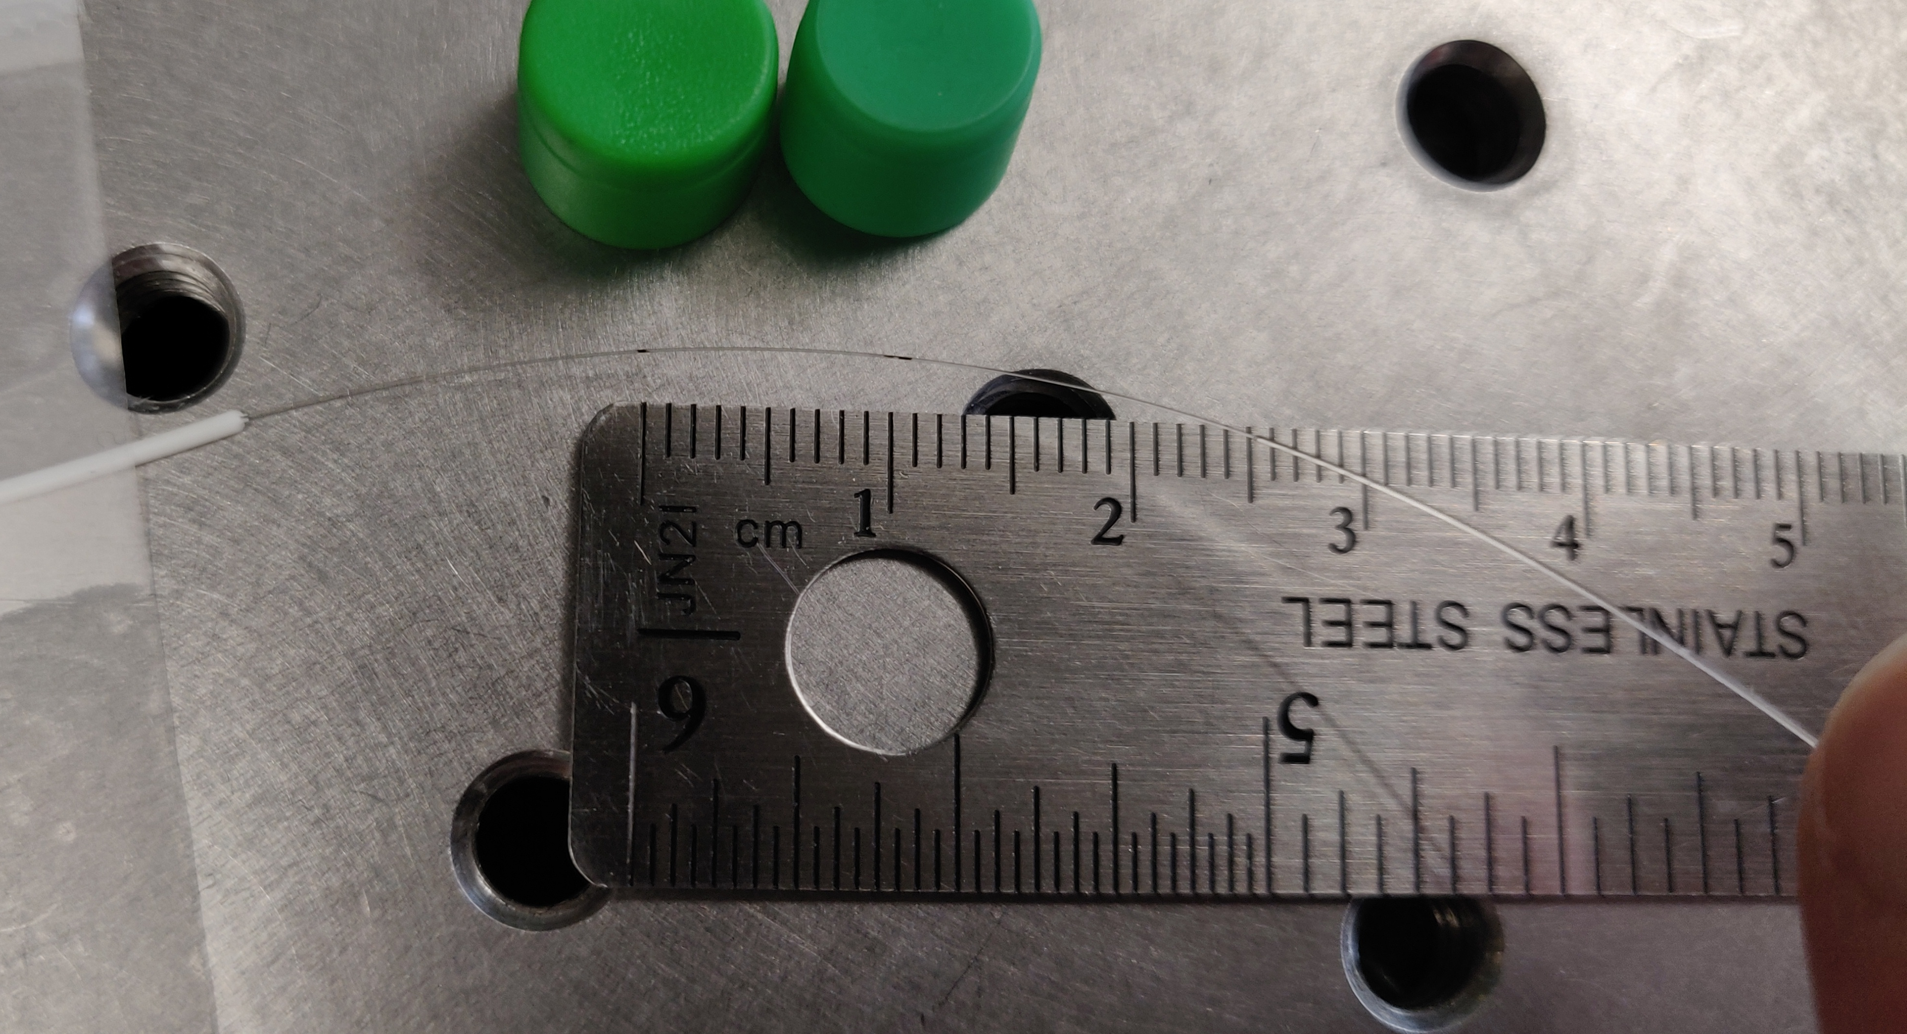
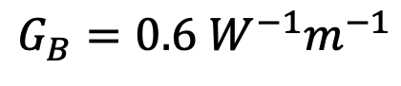
1 cm Germanium-Doped Fiber
$$G_{B}=0.6 W^{−1}m^{−1}$$

Slide 70
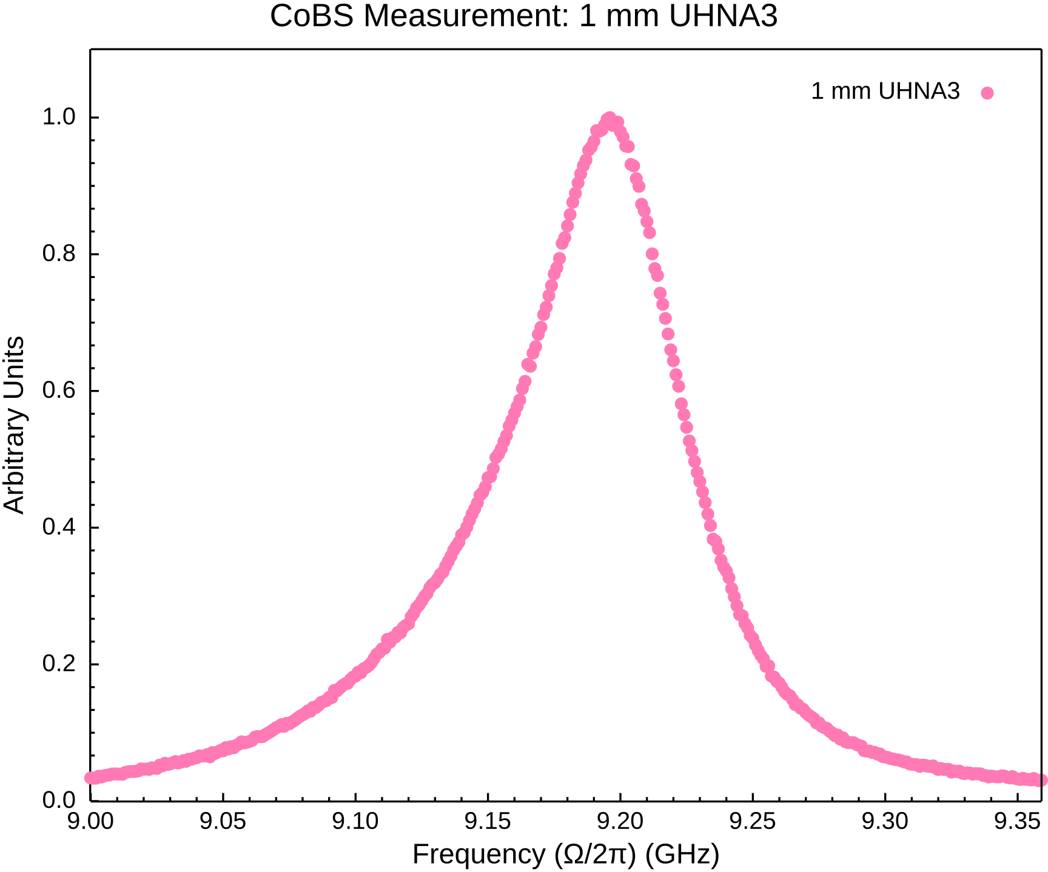
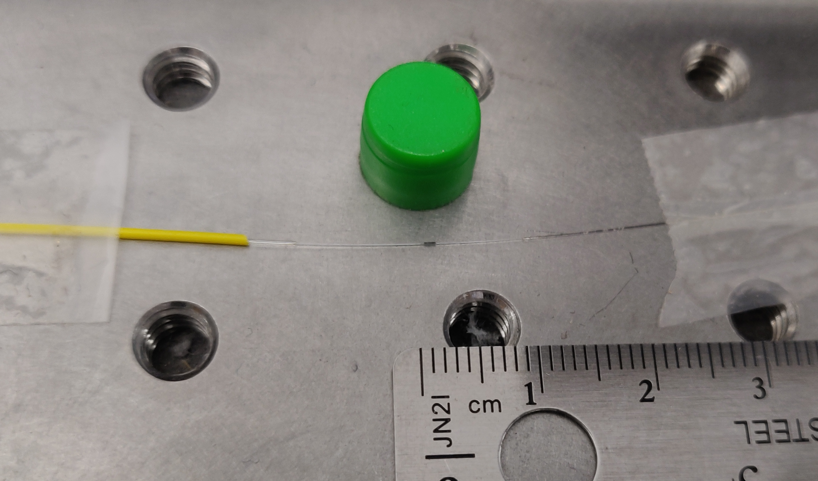
1 mm Germanium-Doped Fiber
$$G_{B}=0.6 W^{−1}m^{−1}$$

Slide 71
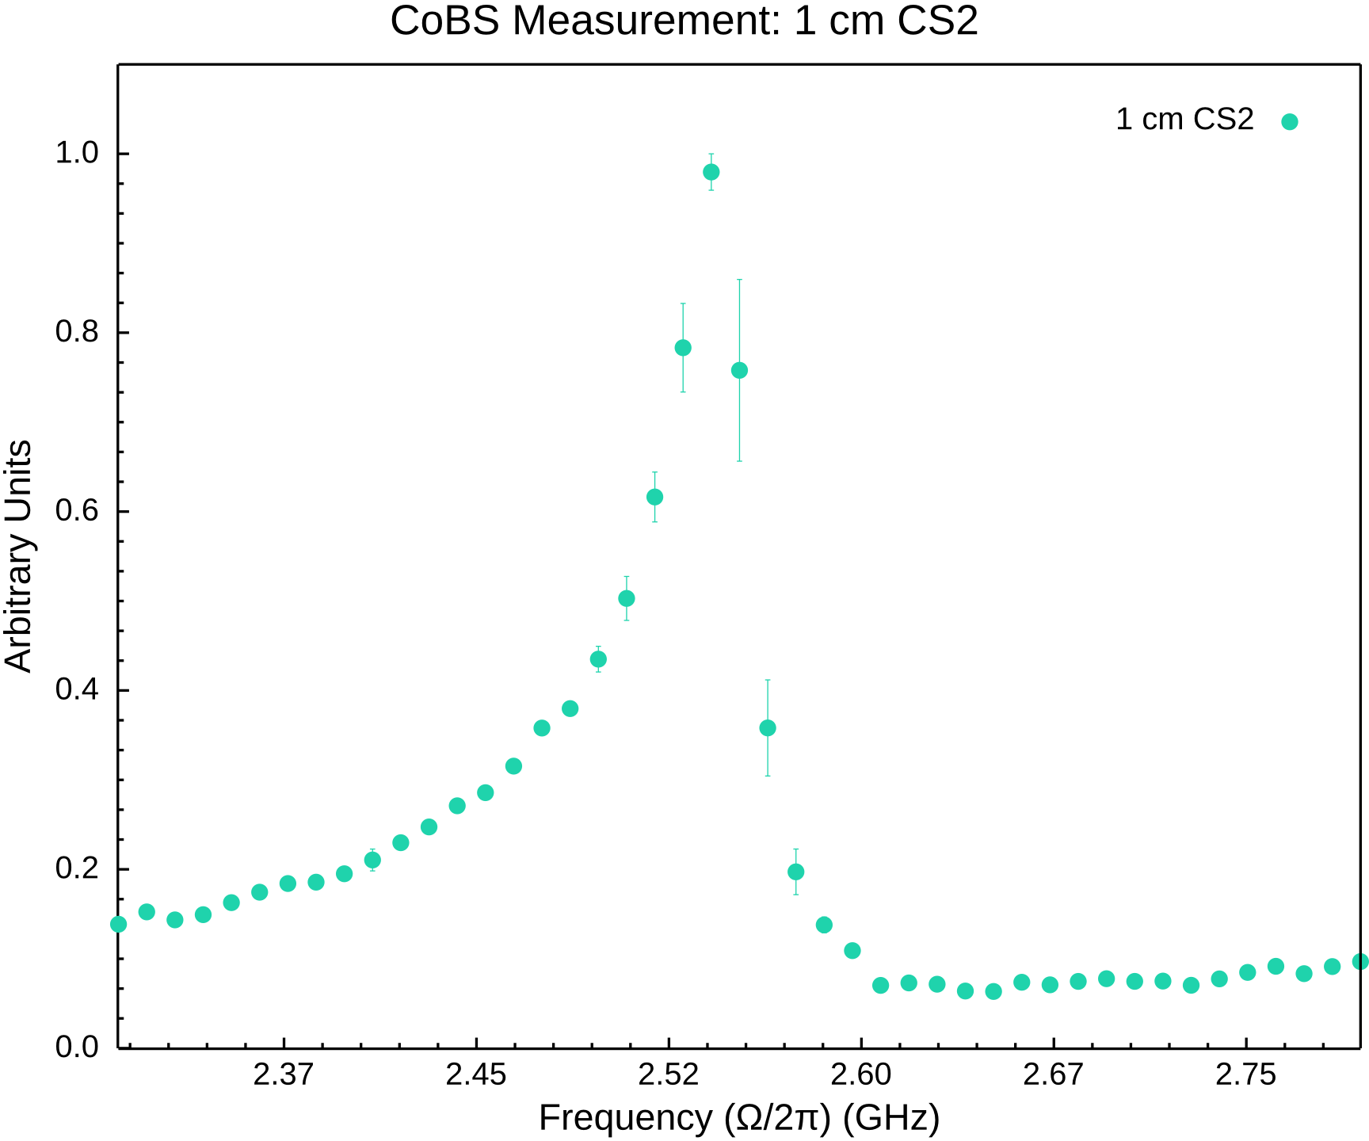
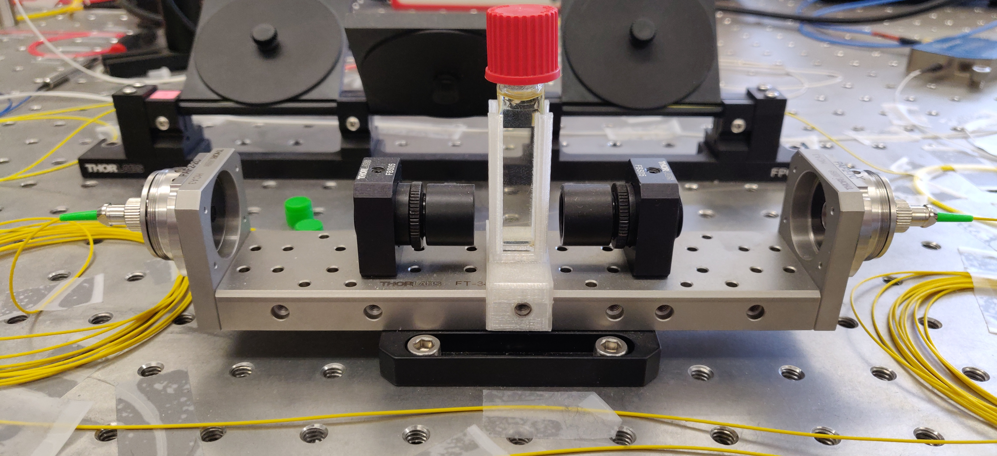
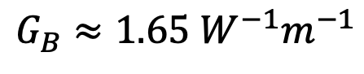
1 cm CS₂
$$G_{B}≈1.65 W^{−1}m^{−1}$$

Slide 72


4 mm CS₂
$$G_{B}≈1.65 W^{−1}m^{−1}$$

Slide 73



1 μm TeO₂
$$G_{B}≈1.1 W^{−1}m^{−1}$$

Slide 74



1 μm TeO₂ Again
5 MHz bins
10 MHz bins
$$G_{B}≈1.1 W^{−1}m^{−1}$$

Slide 75


1 mm CS₂
$$G_{B}≈1.65 W^{−1}m^{−1}$$

Slide 76


100 μm CS₂
$$G_{B}≈1.65 W^{−1}m^{−1}$$

Slide 77


Suspended Silica Chip Waveguide

Slide 78
Controlling Sound with Light
Laser Cooling of Traveling-Wave Phonons in an Optical Fiber
Quieting sound with light

Slide 79
Controlling Sound with Light
Laser Cooling of Traveling-Wave Phonons in an Optical Fiber
Quieting sound with light
Coherently stimulated Brillouin Scattering (CoBS)
Amplifying sound to measure subtle signals

Slide 80
Controlling Sound with Light
Laser Cooling of Traveling-Wave Phonons in an Optical Fiber
Quieting sound with light
Coherently stimulated Brillouin Scattering (CoBS)
Amplifying sound to measure subtle signals
Brillouin-Induced Raman Modes
Harnessing sound for engineered behaviors

Slide 81



Acknowledgements

Slide 82
Optomechanical Cooling
Material at room temperature has thermal fluctuations (phonons)
Ω
phonon

Slide 83
Optomechanical Cooling
Material at room temperature has thermal fluctuations (phonons)
Laser light
Ω
⍵_{P}
phonon

Slide 84
Optomechanical Cooling
Material at room temperature has thermal fluctuations (phonons)
Laser light backscatters off approaching sound wave (Brillouin scattering)
Ω
⍵_{P}
phonon

Slide 85
Optomechanical Cooling
Material at room temperature has thermal fluctuations (phonons)
Laser light backscatters off approaching sound wave (Brillouin scattering)
Energy transfers from sound to light:
Returning light is frequency upshifted (blue-shifted)
⍵_{aS} = ⍵_{P} + Ω
Ω
⍵_{P}
phonon

Slide 86
Optomechanical Cooling
Material at room temperature has thermal fluctuations (phonons)
Laser light backscatters off approaching sound wave (Brillouin scattering)
Energy transfers from sound to light:
Returning light is frequency upshifted (blue-shifted)
Sound wave intensity is lowered (cooled)
⍵_{aS} = ⍵_{P} + Ω
Ω
⍵_{P}
phonon

Slide 87
Optomechanical Cooling
Material at room temperature has thermal fluctuations (phonons)
Laser light backscatters off approaching sound wave (Brillouin scattering)
Energy transfers from sound to light:
Returning light is frequency upshifted (blue-shifted)
Sound wave intensity is lowered (cooled)
⍵_{aS} = ⍵_{P} + Ω
Ω
⍵_{P}
phonon

Slide 88
Optomechanical Cooling
Material at room temperature has thermal fluctuations (phonons)
Laser light backscatters off approaching sound wave (Brillouin scattering)
Energy transfers from sound to light:
Returning light is frequency upshifted (blue-shifted)
Sound wave intensity is lowered (cooled)
anti-Stokes
⍵_{aS} = ⍵_{P} + Ω
Ω
⍵_{P}
phonon

Slide 89
Optomechanical Heating
Material at room temperature has thermal fluctuations (phonons)
Ω
phonon

Slide 90
Optomechanical Heating
Material at room temperature has thermal fluctuations (phonons)
Laser light
Ω
⍵
phonon

Slide 91
Optomechanical Heating
Material at room temperature has thermal fluctuations (phonons)
Laser light backscatters off retreating sound wave (Brillouin scattering)
Ω
⍵
phonon

Slide 92
Optomechanical Heating
Material at room temperature has thermal fluctuations (phonons)
Laser light backscatters off retreating sound wave (Brillouin scattering)
Energy transfers from light to sound:
Returning light is frequency downshifted (red-shifted)
⍵’ = ⍵ - Ω
Ω
⍵
phonon

Slide 93
Optomechanical Heating
Material at room temperature has thermal fluctuations (phonons)
Laser light backscatters off retreating sound wave (Brillouin scattering)
Energy transfers from light to sound:
Returning light is frequency downshifted (red-shifted)
Sound wave intensity is increased (heated)
⍵’ = ⍵ - Ω
Ω
⍵
phonon

Slide 94
Optomechanical Heating
Material at room temperature has thermal fluctuations (phonons)
Laser light backscatters off retreating sound wave (Brillouin scattering)
Energy transfers from light to sound:
Returning light is frequency downshifted (red-shifted)
Sound wave intensity is increased (heated)
⍵’ = ⍵ - Ω
Ω
⍵
phonon

Slide 95
Optomechanical Heating
Material at room temperature has thermal fluctuations (phonons)
Laser light backscatters off retreating sound wave (Brillouin scattering)
Energy transfers from light to sound:
Returning light is frequency downshifted (red-shifted)
Sound wave intensity is increased (heated)
Stokes
⍵’ = ⍵ - Ω
Ω
⍵
phonon

Slide 96
Optomechanical Heating

Slide 97
Amplitudes: Experiment A

Slide 98
Amplitudes: Experiment A

Slide 99
Amplitudes: Experiment A

Slide 100






LCOF Fabrication

Slide 101
Cooling Experiment B

Slide 102
Cooling Experiment B

Slide 103
Cooling Experiment B

Slide 104
Cooling Experiment B

Slide 105
Cooling Experiment B

Slide 106




Phase Matching Bandwidth
Pump-probe separation
$$P_{sig}=\frac{1}{4}{\left(G_{B}L\right)}^{2}P_{P}P_{S}P_{Pr}sinc^{2}\left(\frac{ΔkL}{2}\right)$$
5 GHz
14.5 GHz
26.5 GHz
37 GHz
$$sinc{\left(x\right)}^{2}$$

Slide 107



Sub-10 fW Sensitivity

Slide 108

P, S, Pr Contribute Equally

Slide 109



Fano Resonance
Interference between the signal and the broad background continuum
Occurs when signal intensity is on the order of the background
Relative phases determine asymmetry

Slide 110



Fano Resonance
$$+q / −q$$
Naïve Lorentzian Fit
Fano Fit

Slide 111



Elastically-Suspended Photonic-Phononic

